Slide 1
Democratic Competition IV: Referendums & Party Competition
POL1036: Comparative European Politics – Lecture 14
23/03/2026

Slide 2
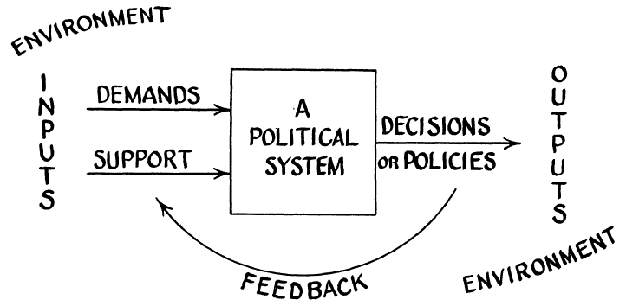
Indirect/Representative Democracy
Easton (1953)
Citizens
Representatives
Decision
=/= parlementary!
Complex System

Slide 3



Versus Direct Democracy
Citizens
Decision
Deliberative Democracy
Referendums
Petitions

Slide 4
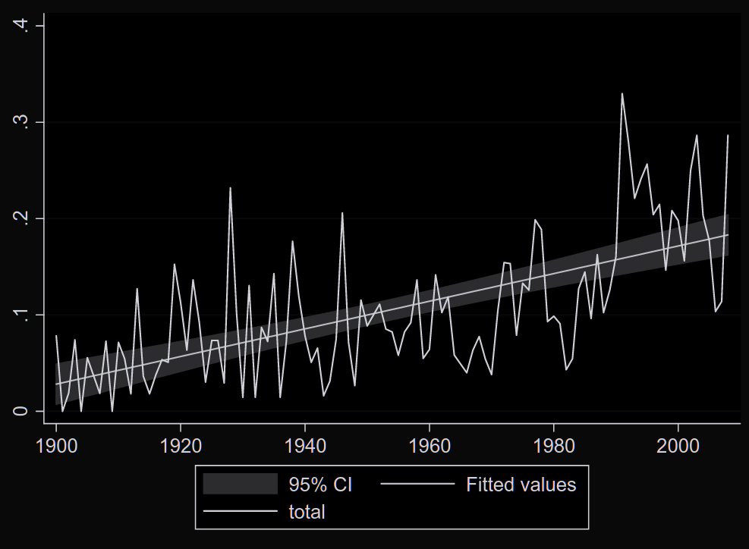
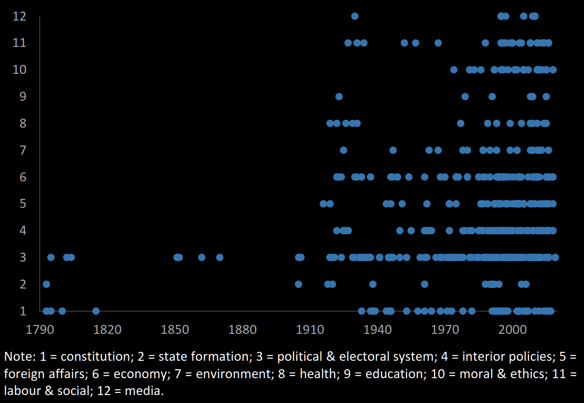
Direct Democratic Shift?
#national ref./country (1900-2010). Source: Altman (2010: 66)
European ref./policy issue (1793-2019).
Source: Silagadze & Gherghina (2020: 472)

Slide 5
Not all referendums are pure reflection of popular sovereignty and thus merely imply a direct democratic shift (Hollander, 2019).

Slide 6
Hamon (1995): Princes, Parties & Citizens
Political Agency: Referendums are used in three ways:
Recourse of the Prince
Recourse of the Parties
Recourse of the Citizens
Hamon: only (3) is about direct democracy
(1) & (2): aimed at strengthening own position => Strategic Motive!
Importance of control over referendum proces

Slide 7



Who controls the referedum?
Top factor: Who triggers the vote? (Hollander, 2019)
Popular Minority Represent. Majority Political Minority
Other factors: Agenda setting, subjects, binding, quorums
Representative majority -> strengthen representative democracy (parties, presidents, ...)

Slide 8
Strategic Motives for political elites
Outcome vs act contingent (organising the referendum)
Bjorklund (1982): Minority weapon vs mediation device vs lightning rod
Qvortrup (2006): empowerment tool
Opperman (2011): quid EU-referendums?
Hollander (2019): four broad strategies
Policy seeking
Empowerment
Conflict Mediation
Depoliticization

Slide 9
Gherghina (2019): How do parties use referendums?
2 Types of action:
Centripetal – Benefit the party itself
Centrifugal – Weaken other parties
2 Types of Intended Goals
Policy - change or protect SQ
Institutional - change or protect power distributions/institutions

Slide 10
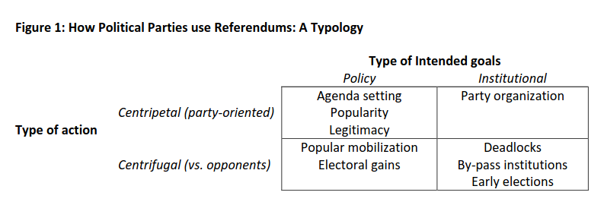
Gherghina (2019): How do parties use referendums?

Slide 11
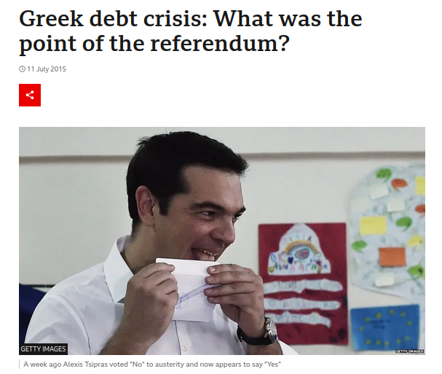
Example: 2015 Greek Bailout Referendum
Greek government-debt crisis
EU & IMF financial bailout conditions, negatively received by Tsipras Government
Referendum called by Tsipras government in order to legitimize its position in negotiations with the EU
Success (61% no-votes), but Tsipras ended up agreeeing to even harsher conditions
https://www.bbc.com/news/world-europe-33492387

Slide 12
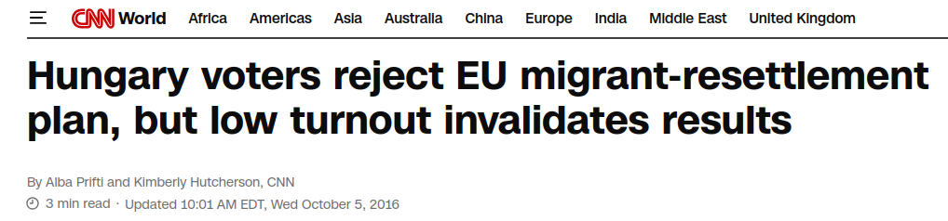
Example: 2016 Hungarian Migrant Quota Referendum
EU migrant crisis & relocation plans
Referendum called by Orban government to mobilize people against opponents
Framed as as defending "the people" from EU-imposed migrant quotas
Opposition campaigned for a boycot to make vote invalid
98% voted no, but turnout <50% and thus invalid

Slide 13


Slide 14
Brexit
Legitimacy: strengthen position in EU negotiations
Electoral gains: weaken position of UKIP in 2015 general elections
Party Organization: mitigate intra-party dissonance over EU membership

Slide 15
Conclusion
Theory
Referendums: poster boy for (direct) democracy
Citizens get more control over political decision-making (at the expense of political actors)
Practice
Referendums strengthen political actors -> party competition
Use of referendums coincides with strategic decisions (political calculus)
Conclusion
No direct democratic shift, but Political agency main factor to understand referendums in democratic competition

